Slide 1
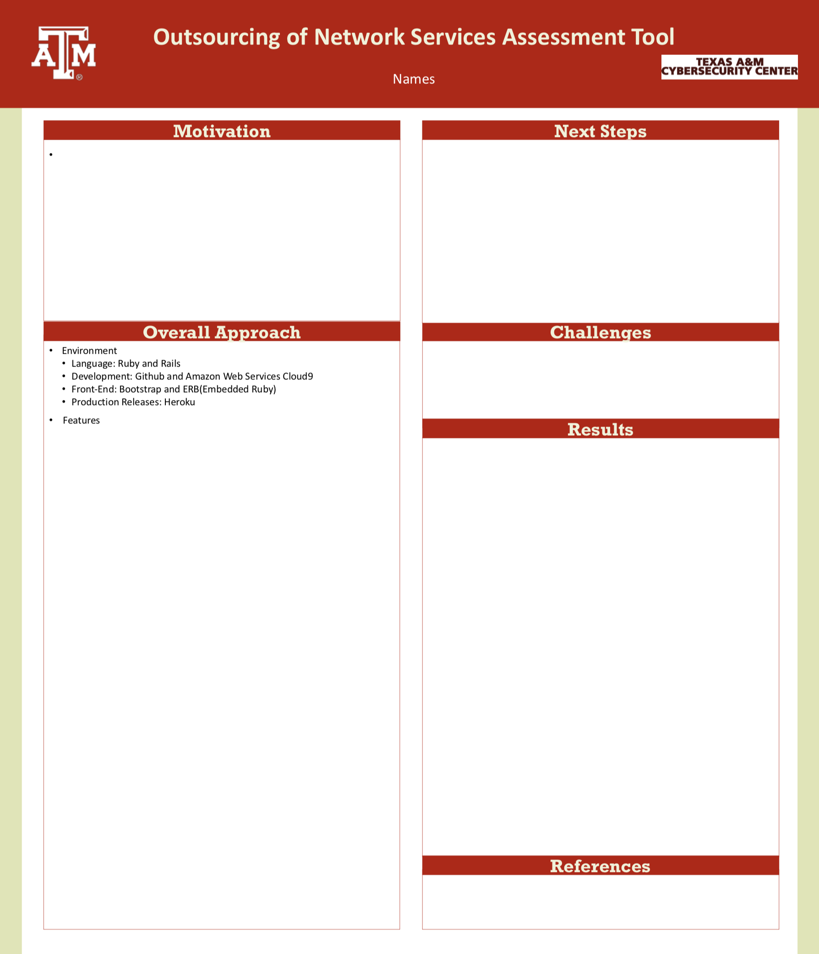
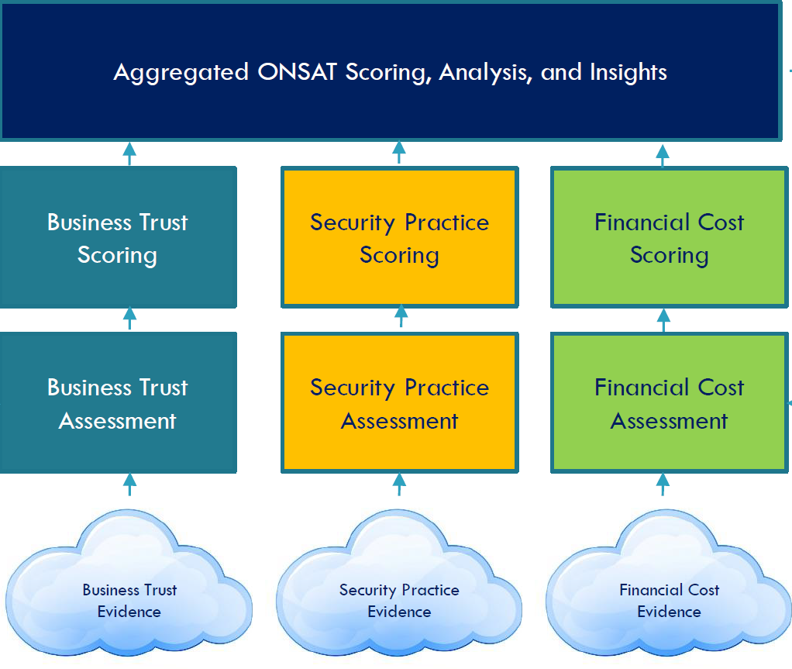
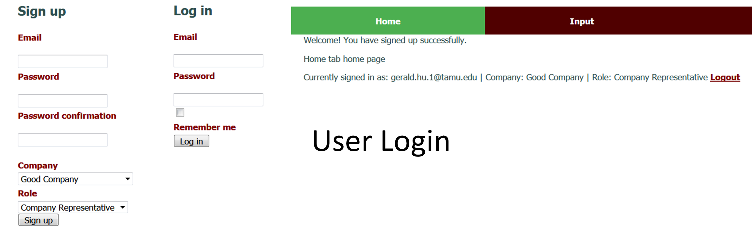
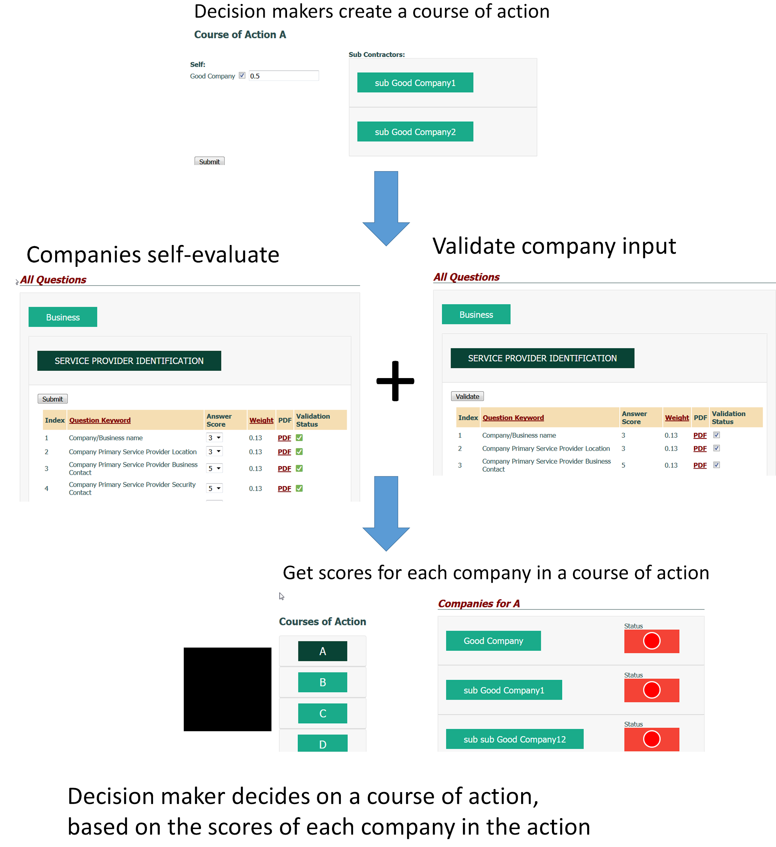
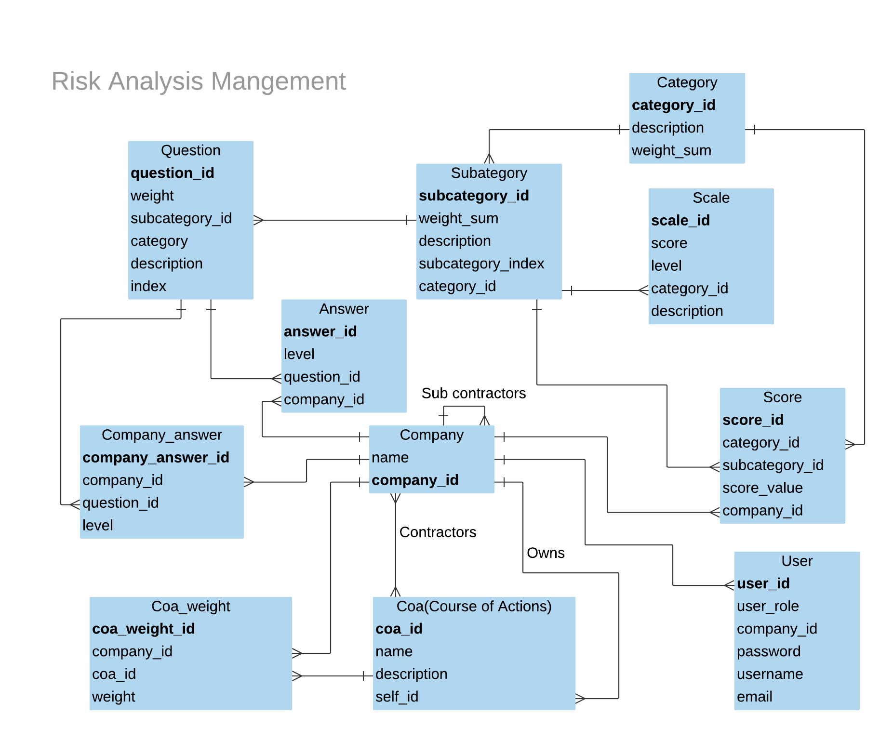
Team Members:
Edward Mondragon, Eikagra Sharma, Chengyi Min, Hyundeok Park, Gerald Hu, Jee Su Byun, Shaolong Chen
Introductions
Major User Stories
The purpose of the ONSAT project is to migrate the evaluation tools managed by a spreadsheet to web-based tools. The purpose of the tools is to evaluate which companies would be best to outsource network services to. The tool helps stakeholders make decisions by charting the Trustworthiness, Security, and Financial scores of the evaluated company. Aside from implementing functions in the spreadsheet, the function of validating each item and configuring decision scenarios improves the completeness of the tool.
Feature: Submit answers and files
As a user of the system
I should be able to submit answers to the system in different ways
Scenario: Submit an existing form to and display the question list
Given I am on the input page
And I choose the file and press upload
Then the file should be parsed
Scenario: Submit answers filled in dropdowns
Given I am on the input page
And I filled out some answers
And I click the submit button
Then my answers should be stored
Other Features
Feature: Validating Answers
Feature: Configuring Scenarios
Feature: Inspecting Final Scores
Feature: Check Formulae
Feature: Log into Different Roles
Motivations
Next Steps
Helping government agencies and companies making decision about outsourcing targets
The original spreadsheet was cumbersome, unclear and inconsistent
Separating users into different roles requires a web style interface
Rendering the interactions between roles more intuitively and efficiently
Integrate the scenario table
Optimizing loading speed
Improving database definitions
Notification from score changes
Subcontractor configuration
Website security Improvements
Database getting more convoluted as the user story incrementally unfolds
Performance problems such as N+1 queries
Serving as a prototype, the system needs to be more open for extension
Decision Making
Validate
Representative
Database Design Diagram
Fox, A., Patterson, D.A. and Joseph, S., 2014. Engineering software as a service: an agile approach using cloud computing. India: Strawberry Canyon LLC.

